Slide 1

Introduction to Artificial neural networks.

Slide 2
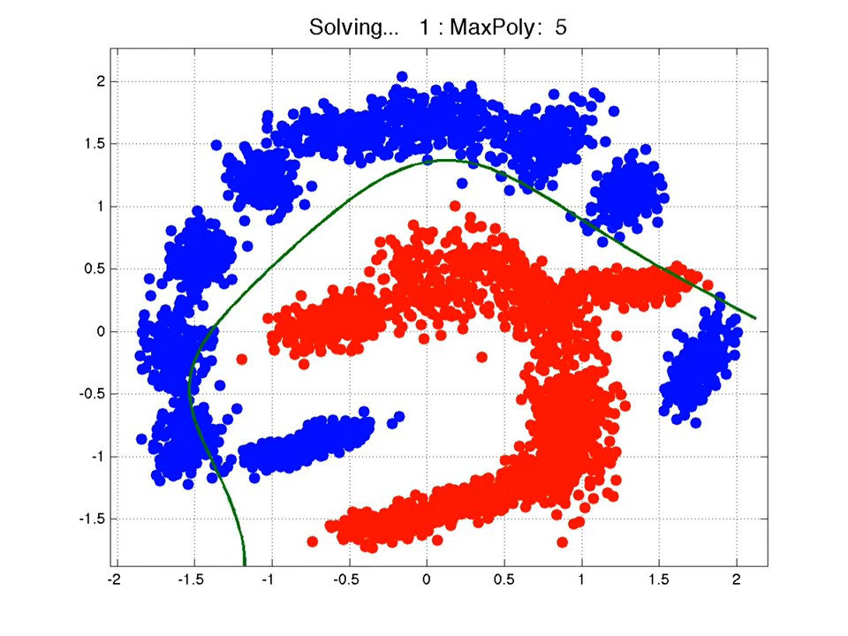

Slide 3
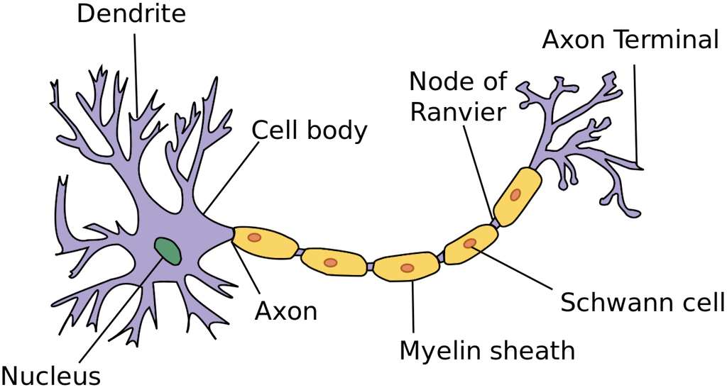
Introduction to biological neural
Dendrites: receives messages from other neurons
Nucleus:
Axon: send messages to other neurons
Synapse: when the axon connect other neuron’s dendritic tree
Notes:
Spike of activity in the axon causes charges to be injected into the post-synaptic neuron.(draw a graph)
A neuron generate spike when it receives enough charge from its’ dendritic tree

Slide 4
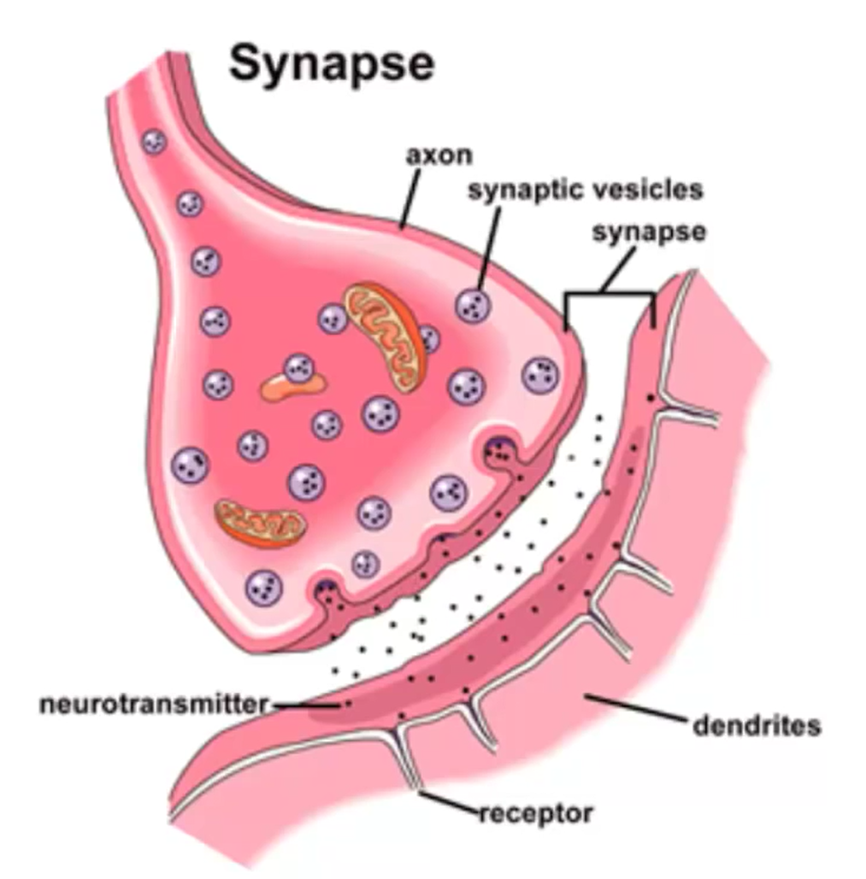
How Synapse works & learning
When an impulse travel down the axon, it eventually reaches the axon terminal.
When it reach the terminal, the change in electrical charge triggers biochemical reactions that lead to the release of neurotransmitter.
They can adapt by varying the number of vesicles of transmitter.
They can adapt by varying the number of receptor molecules.

Slide 5

How Synapse works

Slide 6
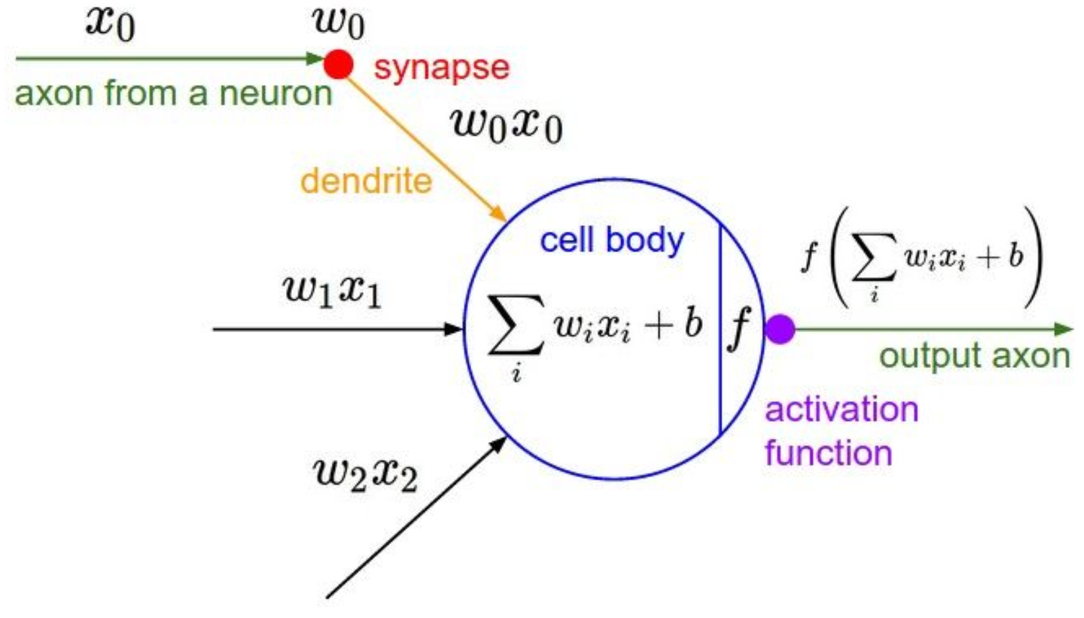
Artificial neural

Slide 7

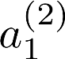
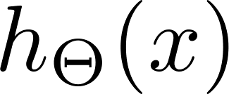

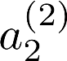
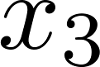
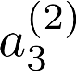
Neural network
Layer 1
Layer 2
Layer 3
Input Layer
Hidden Layer
Output Layer
Notes:
Draw the bias unit and the weights (thetas) victors and input victors.

Slide 8

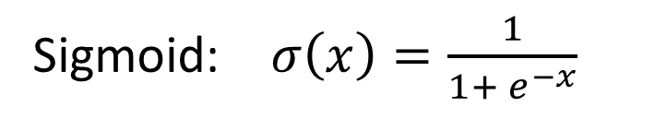

Neuron model: Activation Functions
Sigmoid: $σ\left(x\right)=\frac{1}{1+ e^{−x}}$
LeakyReLu:
tanh: $tanh\left(x\right)$
Maxout:
ReLu: $max\left(x,0\right)$
ELU:

Slide 9
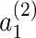
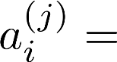
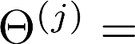
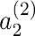
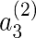
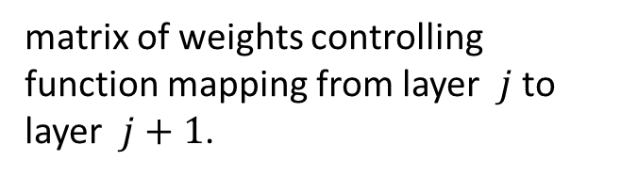


Neural network
“activation” of unit $i$ in layer$j$
matrix of weights controlling function mapping from layer $j$ to layer $j+1$.
If network has $u_{j}$ units in layer $j$ , $u_{j+1}$units in layer $j+1$, then $θ^{(j)}$
will be of dimension $u_{j+1} ×(u_{j}+1)$.
Notes:
Ask why the one in the dimension of theta.
The answer is because of the bias.

Slide 10
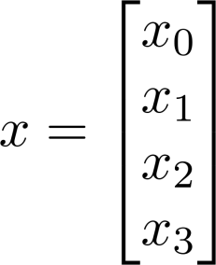
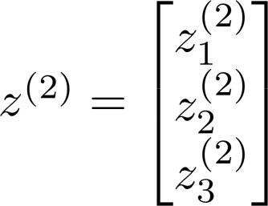
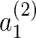
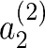
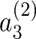
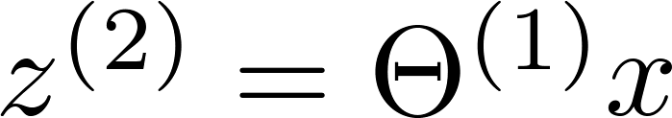
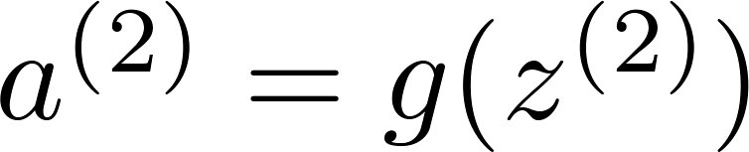
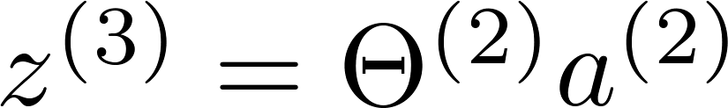
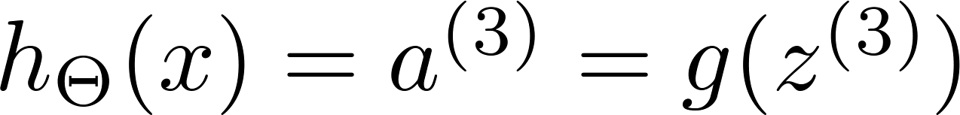

Neural network forward propagation
Add $a_{0}^{(1)}=1$.

Slide 11

Neural network zoo

Slide 12
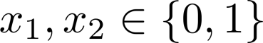
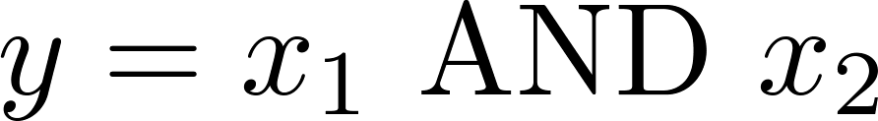
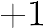
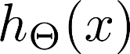
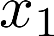
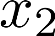
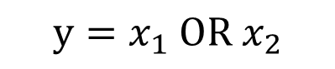
Simple example: AND
Example: OR function
1.0
$$y=x_{1} OR x_{2}$$
0 | 0
0 | 1
1 | 0
1 | 1
Notes:
Draw the sigmoid function assuming the result is near 1 at 5 and near 0 at -5, and then ask the student to try find the prober weights to make an AND , OR gate

Slide 13
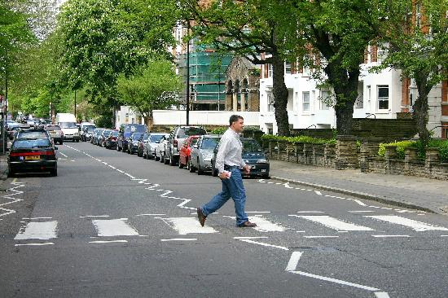

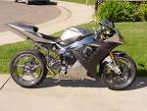
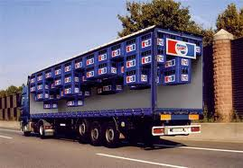

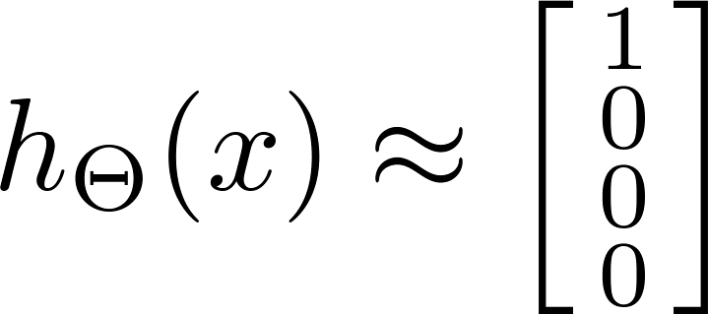

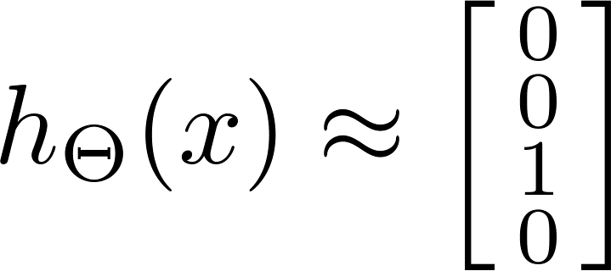
Multi-class classification
Pedestrian
Car
Motorcycle
Truck
Want , , , etc.
when pedestrian when car when motorcycle

Slide 14
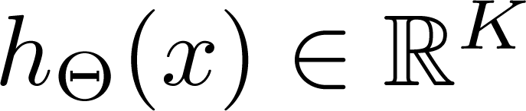
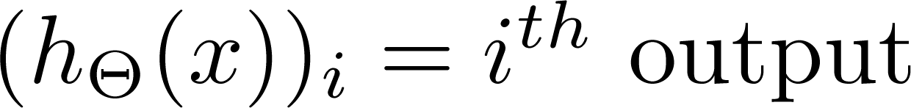
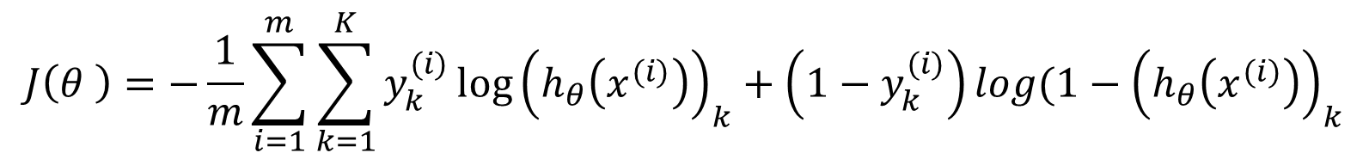
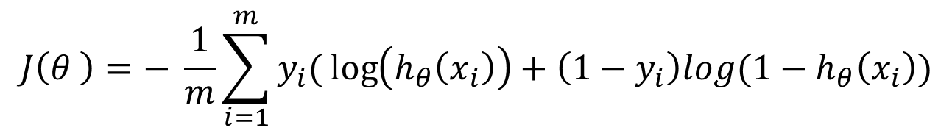
Neural network learning: Cost function
Logistic regression:
$$J\left(θ \right)=− \frac{1}{m}\sum_{i=1}^{m}{y_{i}(}\log\left(h_{θ}\left(x_{i}\right)\right)+\left(1−y_{i}\right)log(1−h_{θ}\left(x_{i}\right))$$
Neural network:
$$J\left(θ \right)=−\frac{1}{m}\sum_{i=1}^{m}{\sum_{k=1}^{K}{y_{k}^{(i)}}{\log\left(h_{θ}\left(x^{(i)}\right)\right)}_{k}+\left(1−y_{k}^{(i)}\right){log(1−\left(h_{θ}\left(x^{(i)}\right)\right)}_{k}}$$

Slide 15



Notes:
http://cs.stanford.edu/people/karpathy/convnetjs/demo/classify2d.html

